Slide 1
CIMBA Italy Study Abroad Programs www.cimbaitaly.com

Slide 2
What is CIMBA?
Dynamic cross-cultural business curriculum
Innovative leadership development
Gateway to explore Italy & Europe
Immersive international experience
Small & personal by design
Smart investment in professional toolbox

Slide 3
Classroom Environment
Professors from around the world
English-language coursework
Smaller class size
Interactive & discussion-based
International components
Cultural application of coursework
Company tours
Networking opportunities

Slide 4
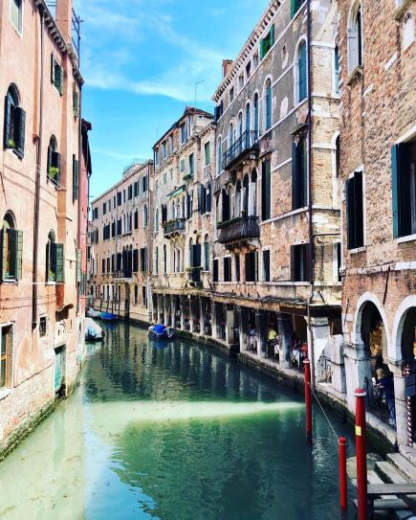
Semester or Summer
Semester Study Abroad
Fall or Spring
12 weeks
Complete 12-18 credit hours
25+ days of independent travel
Leadership certification
Summer Study Abroad
4 weeks
6 credits
2 extended travel weekends
Boost your resume

Slide 5
Important Deadlines
Summer
Suggested application: February 15th
Mandatory financial aid: March 1st
Fall
Suggested application: April 15th
Mandatory financial aid: May 1st
Spring
Suggested application: October 15th
Mandatory financial aid: October 15th

Slide 6
Questions?
CIMBA-ITALY@UIOWA.EDU
www.cimbaitaly.com
319-335-0920
C300 PBB
Iowa City, IA

