Slide 1
Information Session
CIMBA Italy Study Abroad Programs Undergraduate

Slide 2
What is CIMBA?
Dynamic cross-cultural business curriculum
Innovative leadership development
Gateway to explore Italy & Europe
Immersive international experience
Small & personal by design
Smart investment in professional toolbox

Slide 3
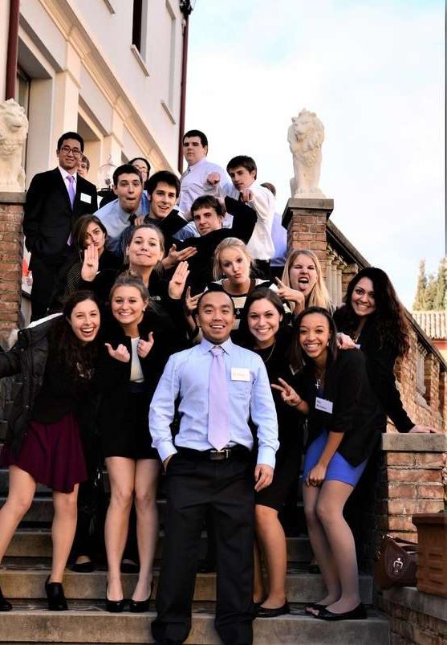
What is CIMBA?
Undergraduate,
Graduate, & MBA
Primary majors:
Business
Economics
Leadership
Engineering
Italian Language & Culture
General Education

Slide 4
Where is CIMBA?
Paderno del Grappa, Italy
One hour north of Venice
Gateway to travel in Europe at the base of Dolomite Mountains
Highly entrepreneurial region
Gated campus at Istituti Filippin

Slide 5
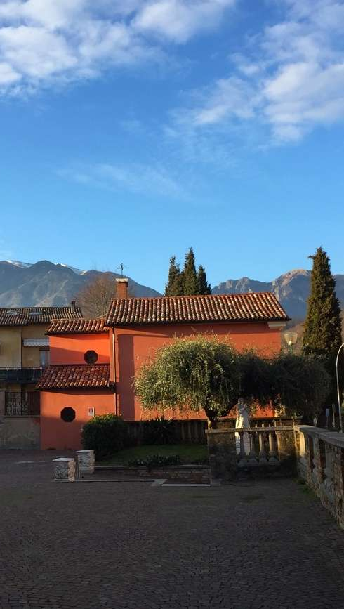
Where will I live?
Full-service & on-campus room & board
Single & double dorm rooms
Private baths
Classrooms on-site
Library & computer labs
Cafeteria
Sports complex
Laundry facilities
Nurse
WiFi

Slide 6
Classroom Environment
Professors from around the world
English-language coursework
Smaller class size
Interactive & discussion-based
International components
Cultural application of coursework
Company tours
Networking opportunities

Slide 7
Semester or Summer
(undergraduate)
Semester
Fall or Spring
12 weeks
12-18 credits
25+ days of independent travel
Leadership certification
Summer
May – June
4 weeks
6 credits
2 extended travel weekends

Slide 8
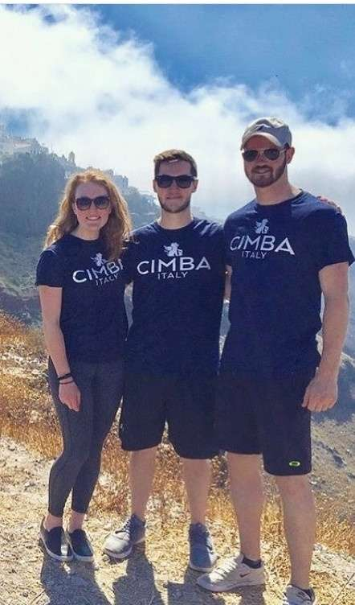
Leadership Institute
CAP – CIMBA Advantage Program
2-week on-campus orientation
LIFE – Leadership Initiatives for Excellence
3-day leadership training
Enhance leadership skills & personal development
Connect with classmates
LEAP – Learn, Enrich, Achieve, Perform
Semester-long & for credit
1-on-1 & group coaching sessions
Self-assessment & development seminars

Slide 9
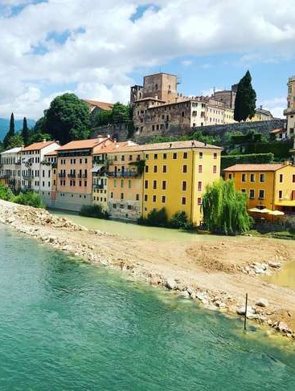
Cultural Exploration Program
Gourmet dinners
Evening with a professor
Pizza-making
Pasta-making
Add a Seat to the Table
Volunteer opportunities
Intramurals & athletics

Slide 10
Travel
100% independent
Semester travel breaks:
10-day travel week (mid-semester break)
2 extended travel weekends
Summer travel breaks:
2 extended travel weekends
Before or after program

Slide 11
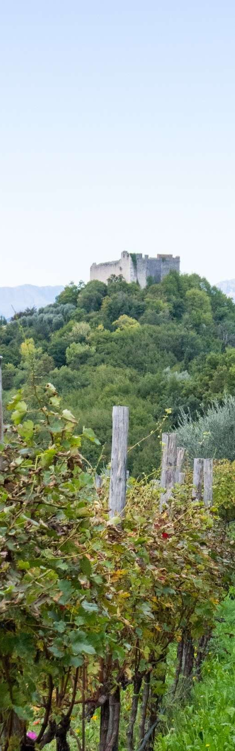
What does it cost?
Spring or Fall Example:
Summer Example:
12 Weeks | Tuition: $9,360
12 – 18 Credits | Room & Board: $6,985
25 Travel Days | Student Fees: $950
No Visa Required! (US Citizens) | Total Cost: $17,295
4 Weeks | Tuition: $4,000
6 Credits | Room & Board: $2,200
8 Travel Days | Student Fees: $430
No Visa Required! (US Citizens) | Total Cost: $6,650
(Examples before financial aid)
Amenities include:
3-meals/day plan, linen service, laundry access, cultural exploration program, international insurance, technology fee, and more

Slide 12
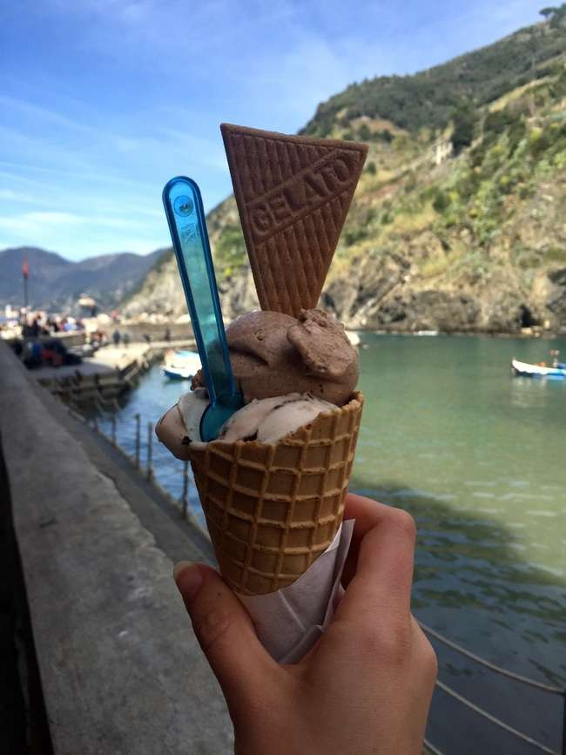
Financial Aid
Federal financial aid applies
Set up your account for direct deposit
CIMBA scholarships & awards
Need & merit-based awards
RA scholarship
Blog ambassador
Social media team
Study abroad office scholarships
Payment plans available
Check with your school & college!

Slide 13
Application & Admission
Check with your advisor!
Admission Requirements
18 years or older
Sophomore status and/or required prerequisites
Approval from home university to study abroad, including good academic and disciplinary standing
2.5 GPA or higher, depending on home university requirements
Valid passport or ability to obtain one
Ability to obtain an Italian visa if necessary (applies only to non-US and non-EU citizens)
Application Process
CIMBA & Your University page
Apply online at www.cimbaitaly.com

Slide 14
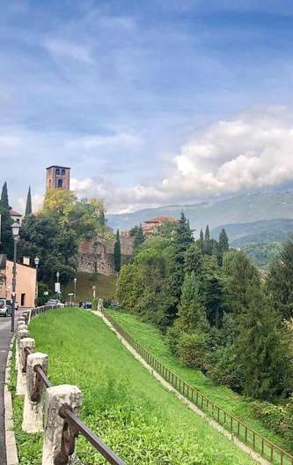
Important Deadlines
Summer
Suggested application: February 15th
Mandatory financial aid: March 1st
Fall
Suggested application: April 15th
Mandatory financial aid: May 1st
Spring
Suggested application: October 15th
Mandatory financial aid: October 15th

Slide 15
Questions?
studyabroad@cimbaitaly.com
www.cimbaitaly.com
319-335-0920

