Slide 1
Information Session
CIMBA Italy Study Abroad Programs Graduate Summer Sessions

Slide 2
What is CIMBA?
Consortium of over 35 universities
Dynamic cross-cultural experience
MBA, Macc, and other areas of study
Accredited by top-ranked University of Iowa Tippie College of Business

Slide 3
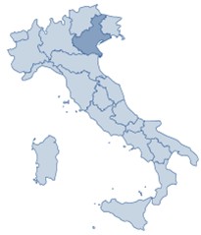
Where is CIMBA?
Paderno del Grappa
One hour from Venice
Authentic small Italian town
Veneto region
Base of the Italian Alps
Epicenter of Italian commerce & entrepreneurship
Cities: Verona, Padua, Venice
Companies: Benetton, Northface, Tecnica, more

Slide 4
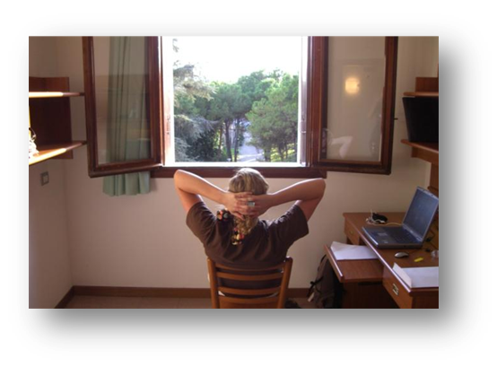
Where will I live?
Istituti Filippin campus
Amenities available
Dorm rooms
Private Bath
Classrooms
Library
Computer rooms
Cafeteria
Sports complex
Laundry
Nurse

Slide 5
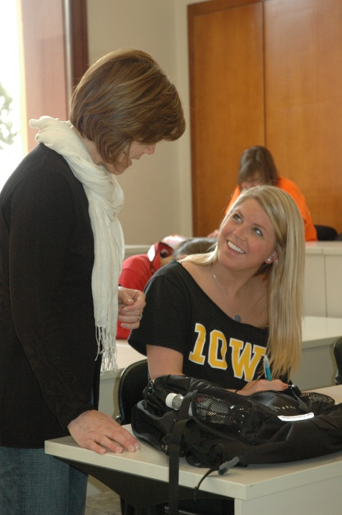
Classroom Environment
Upper-level business electives
Highly-regarded U.S. professors
Coursework
Small class size
Taught in English
Interactive & discussion-based
International component
Company Tours
Coursework application
Networking opportunities

Slide 6
Summer 2017: Session I
Topics in Management Science: Lean Six Sigma
Pat Hammett
University of Michigan
May 15-25, 2017
3 credit hours
1 travel weekend

Slide 7
Daily Schedule
Breakfast
Morning class block
3 hours
Lunch break
Afternoon class block
2 hours
Dinner
Evening campus activities & homework

Slide 8
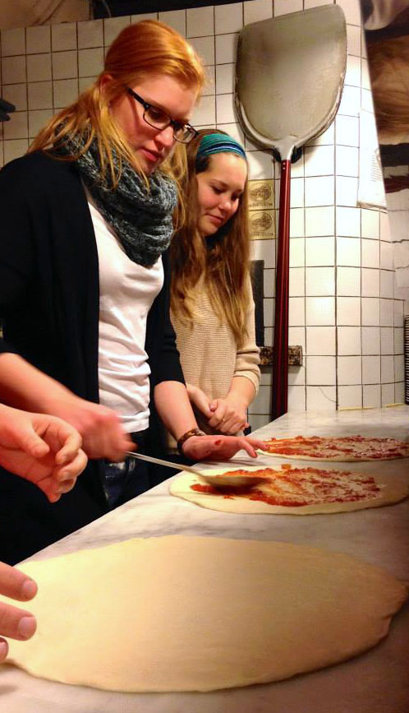
Cultural Activities
Etiquette seminar
Gourmet Italian dinner & networking session
Wine appreciation
Pizza-making
Pasta-making

Slide 9
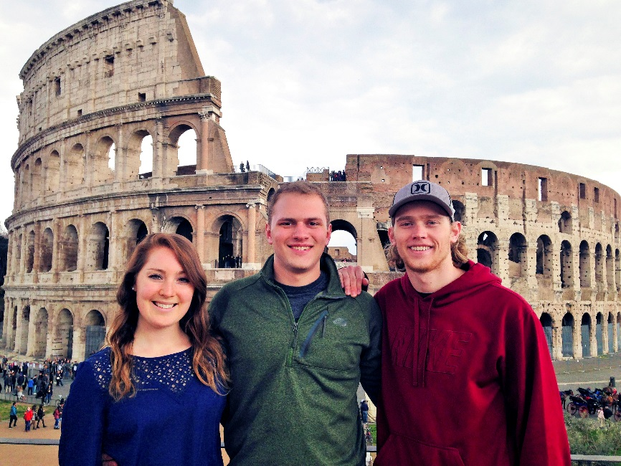
Travel
Before and after session(s)
1 weekend per session

Slide 10
What does it cost?
Cost per session: $3,100
Cost includes:
Tuition
Living arrangements
Meal plan (3/day)
Textbook rental
Housekeeping & linens
Laundry
CISI insurance

Slide 11
Financial Aid
Federal financial aid applies
Set up your account for direct deposit
CIMBA scholarships & awards
Need & merit-based awards
Study abroad office scholarships
Payment plans available
Check with your school & college

Slide 12
Application & Admission
Meet with your advisor
Admission Requirements
18 years or older
Sophomore status and/or required prerequisites
Approval from home university to study abroad, including good academic and disciplinary standing
2.5 GPA or higher, depending on home university requirements
Valid passport or ability to obtain one
Ability to obtain an Italian visa if necessary (applies only to non-US and non-EU citizens)
Application Process
CIMBA & Your University page
Apply online at www.cimbaitaly.com

Slide 13
Questions?
studyabroad@cimbaitaly.com
www.cimbaitaly.com
319-335-0920

