Slide 1
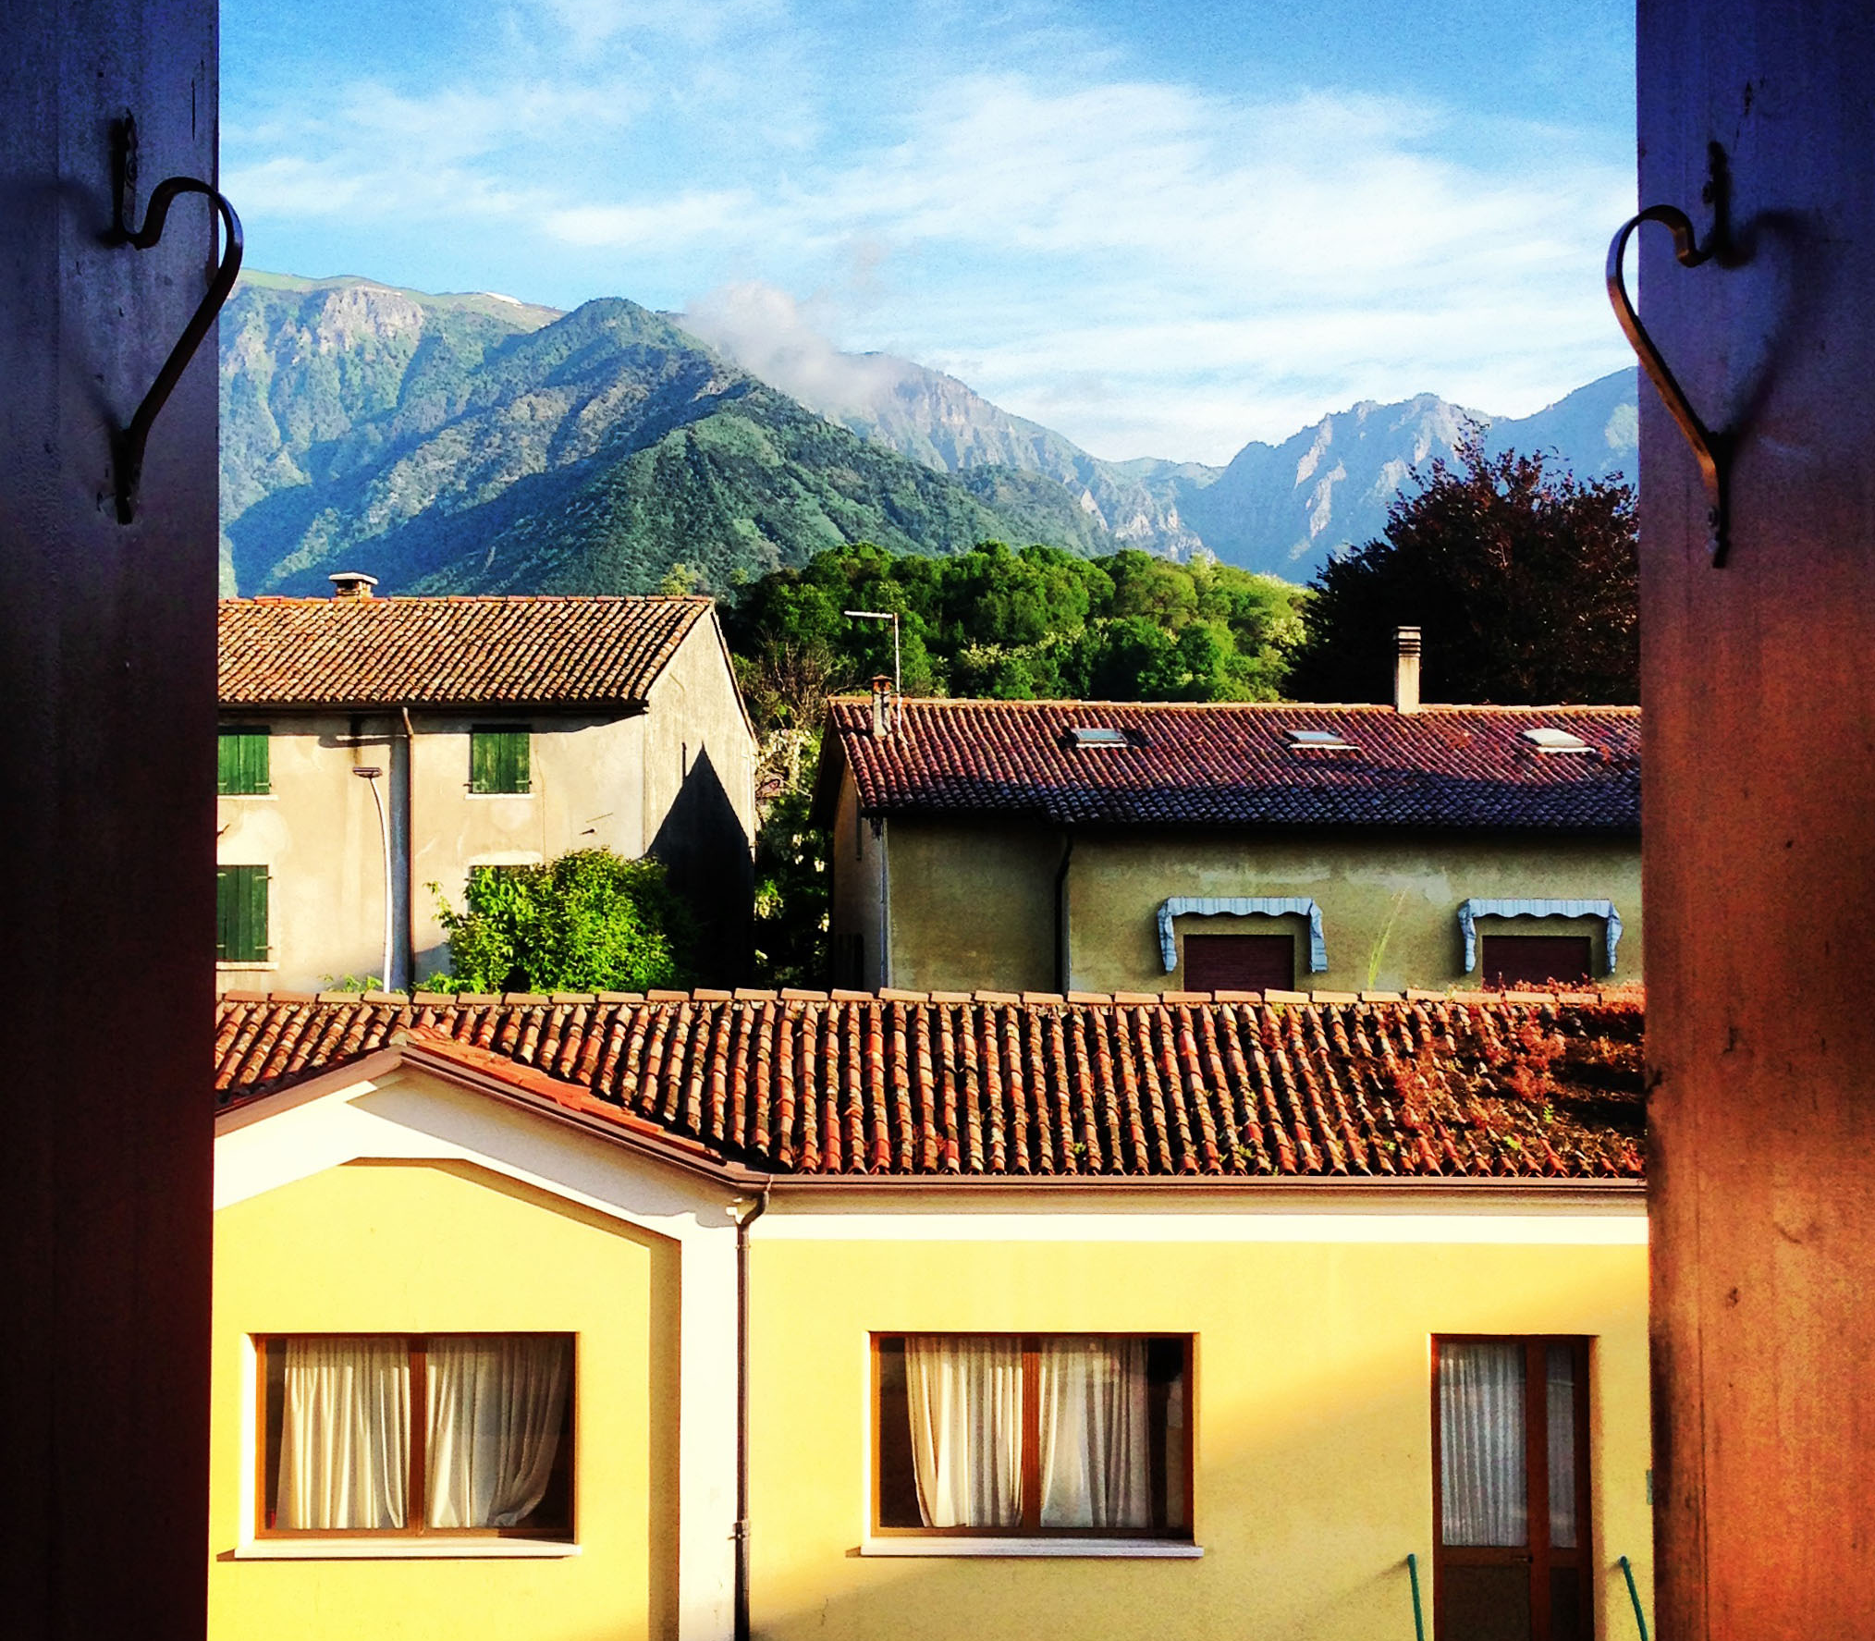
www.cimbaitaly.com

Slide 2
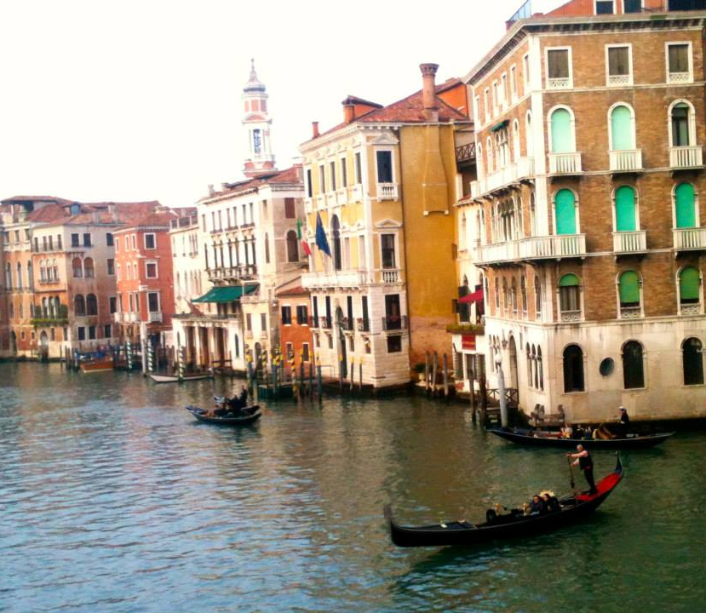
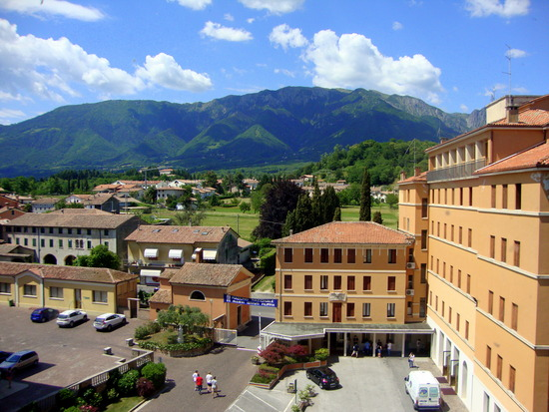
WHAT IS CIMBA?
Business, leadership, & personal development
Extensive travel opportunities
Company tours & networking
Small & personal by design
Undergraduate, graduate, & MBA
Coursework in:
• Business • Communications
• Leadership • Engineering
• Italian Language & Culture

Slide 3
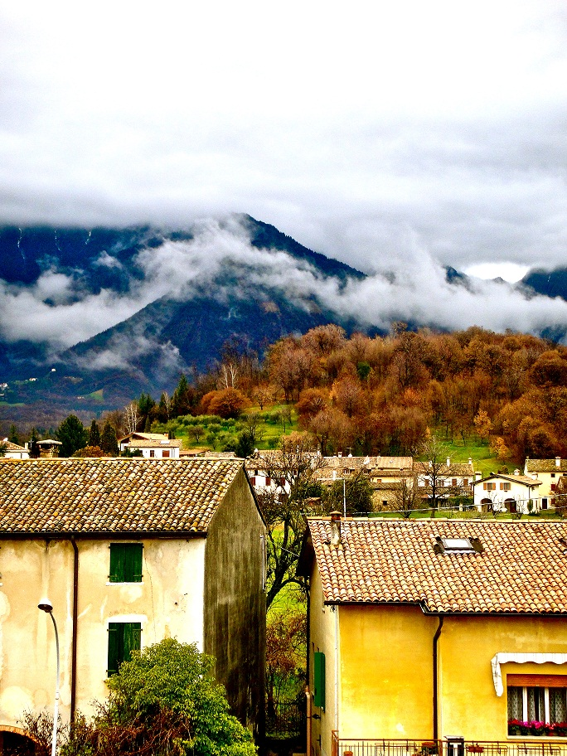
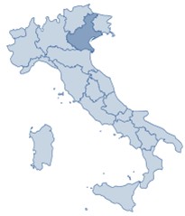
WHERE IS CIMBA?
Paderno del Grappa
One hour from Venice
Authentic small Italian town
Veneto region
Base of the Italian Alps
Epicenter of Italian commerce
Cities: Verona, Padua, Venice
Companies: Benetton, Northface, Tecnica, more

Slide 4
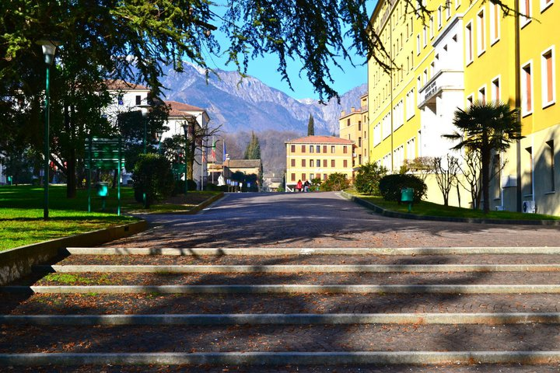
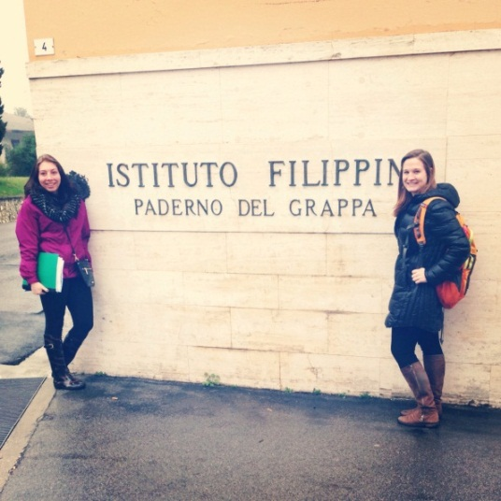
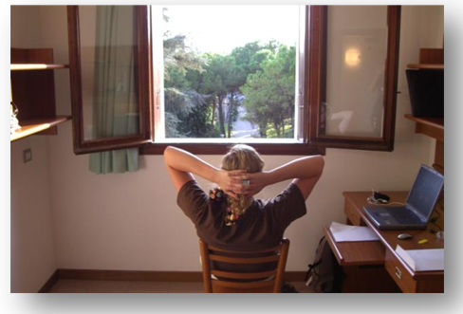
WHERE WILL YOU BE LIVING?
Istituto Filippin campus
Amenities available
Dorms
Classrooms
Library
Computer rooms
Cafeteria
Sports complex
Laundry
Nurse

Slide 5
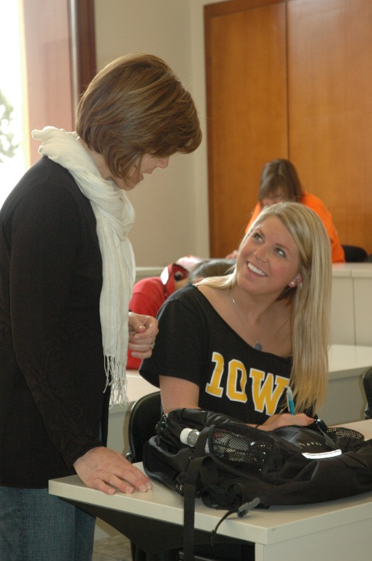
CLASSROOM ENVIRONMENT
Faculty & students from around the world
Courses
Small size
Interactive & discussion-based
International component
Company tours
Coursework application
Networking opportunities

Slide 6
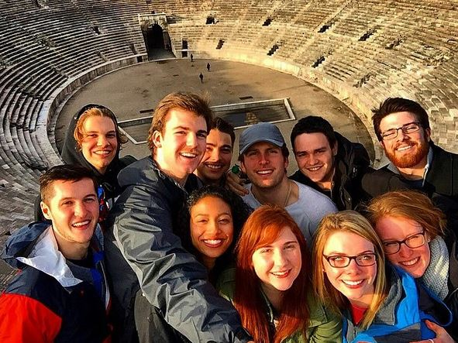
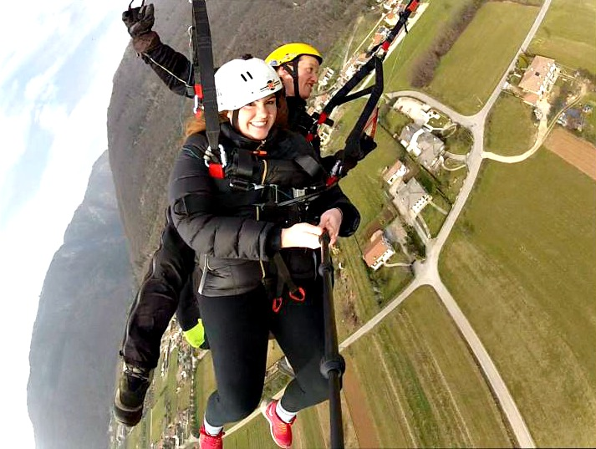
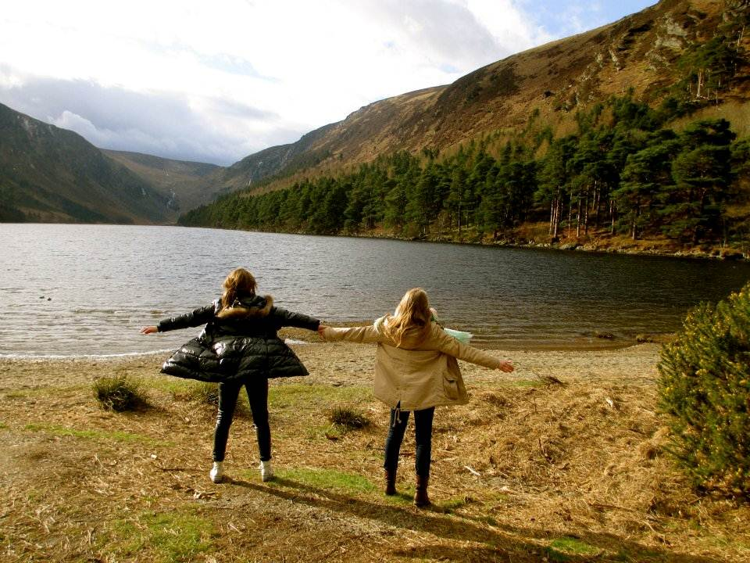
SEMESTER VS. SUMMER
Semester
Fall or Spring
12 weeks
12-18 credit hours
25+ days travel
Leadership certification
Summer
May-June
4 weeks
6 credit hours
2 extended travel weekends

Slide 7
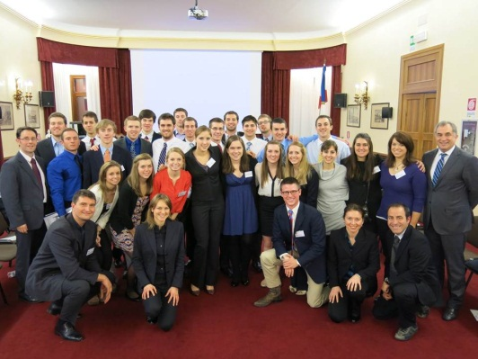
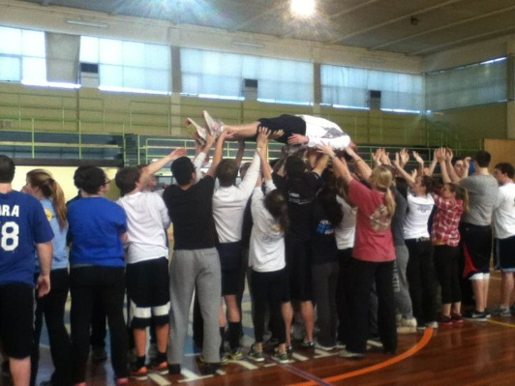
LEADERSHIP INSTITUTE
CIMBA Advantage Program (CAP)
2-week orientation program
Kepner-Tregoe & Team-building
Da Vinci Challenge
Leadership Initiatives in Excellence (LIFE)
1 credit hour
2.5-day leadership training
Learn, Enrich, Achieve, Perform (LEAP)
3 credit hours
Semester-long personal & professional development
1-on-1 & group coaching sessions
Self-assessment & development seminars
Mindfulness

Slide 8
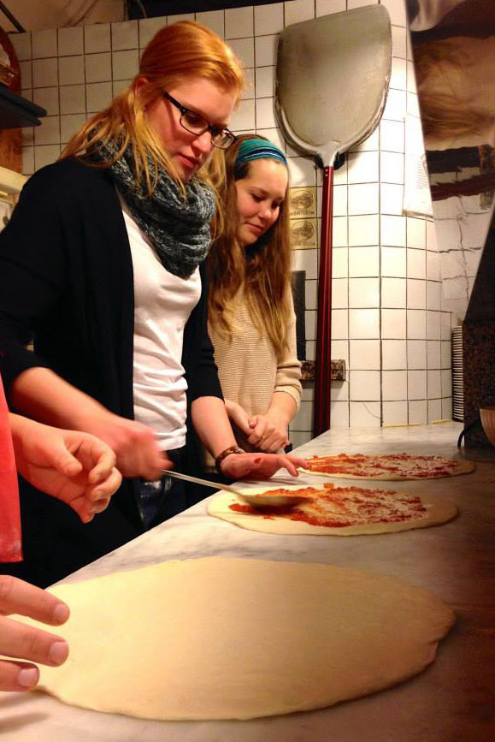
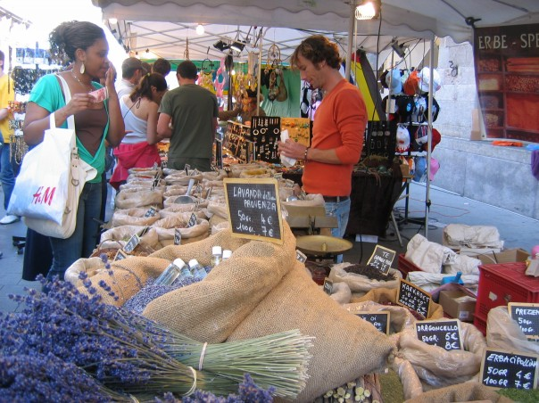
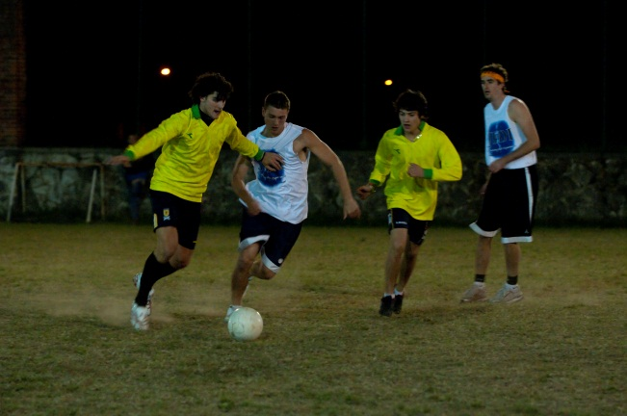
ACTIVITIES AROUND PADERNO
Cultural Exploration Program
Evening with a professor
Add a seat to the table
Gourmet dinners
Wine appreciation
Pizza & Pasta-making
Student life
Market in Crespano
Hike & Paraglide from Mt. Grappa
Gelato in Castelcucco
Pizza in Asolo
Yearbook & newsletter
Italy vs CIMBA intramurals

Slide 9
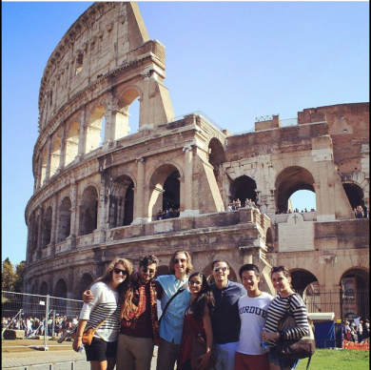
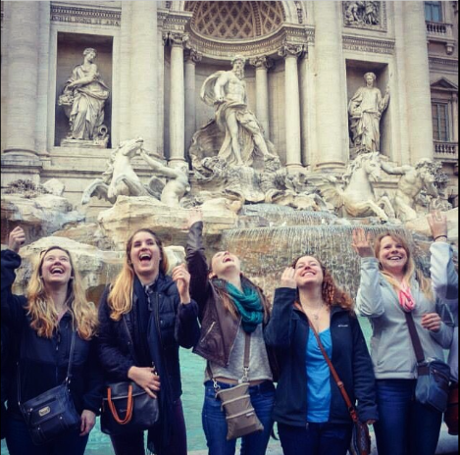
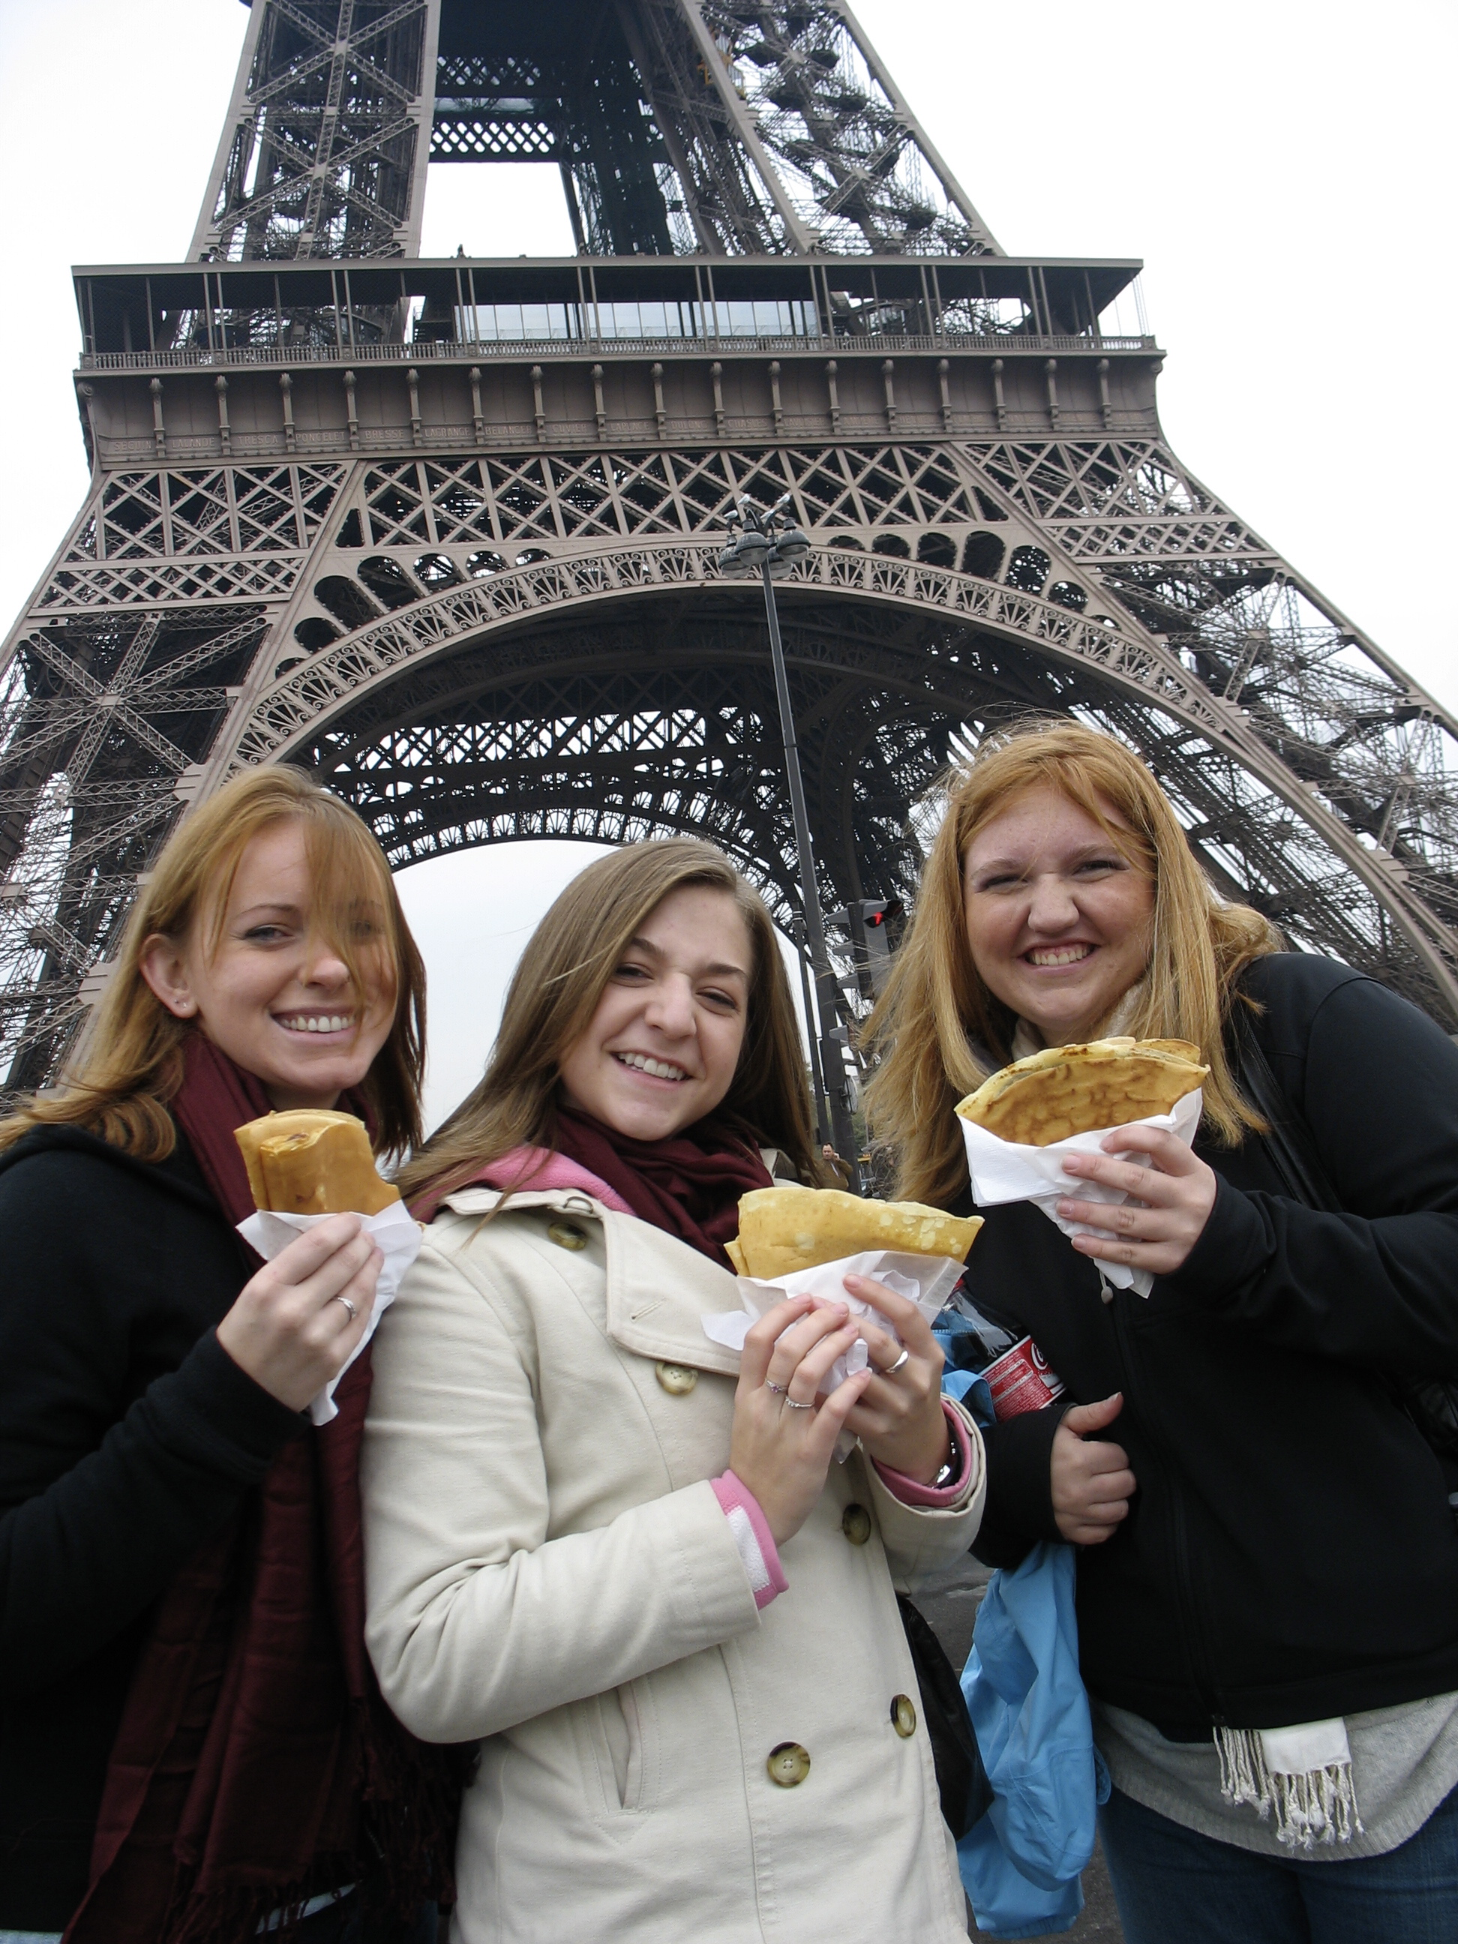
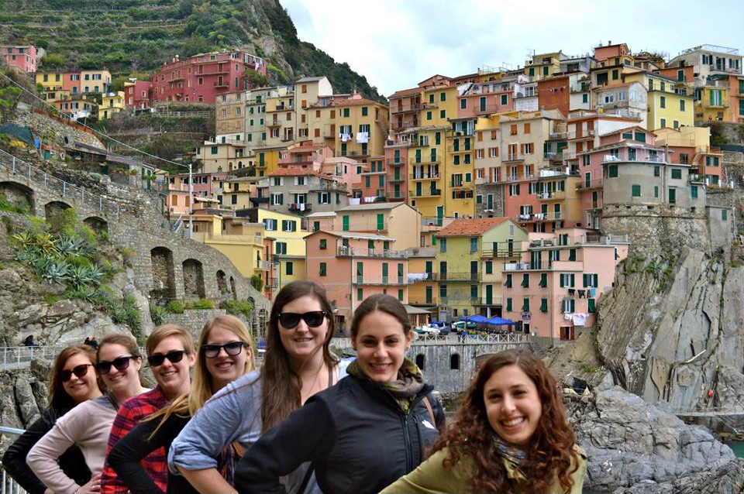
TRAVEL
100% independent travel
Semester opportunities
1 travel week
Extended travel weekends
25+ days total travel days
Summer opportunities
2 extended travel weekends
Travel before & after
When you get on the wrong train, going the wrong direction, in the wrong country, not knowing the language, without a ticket; you will learn more than you would in any classroom. These are the problem solving skills that you learn while you are abroad. This is the European experience.
- Al Ringleb. CIMBA Founder

Slide 10
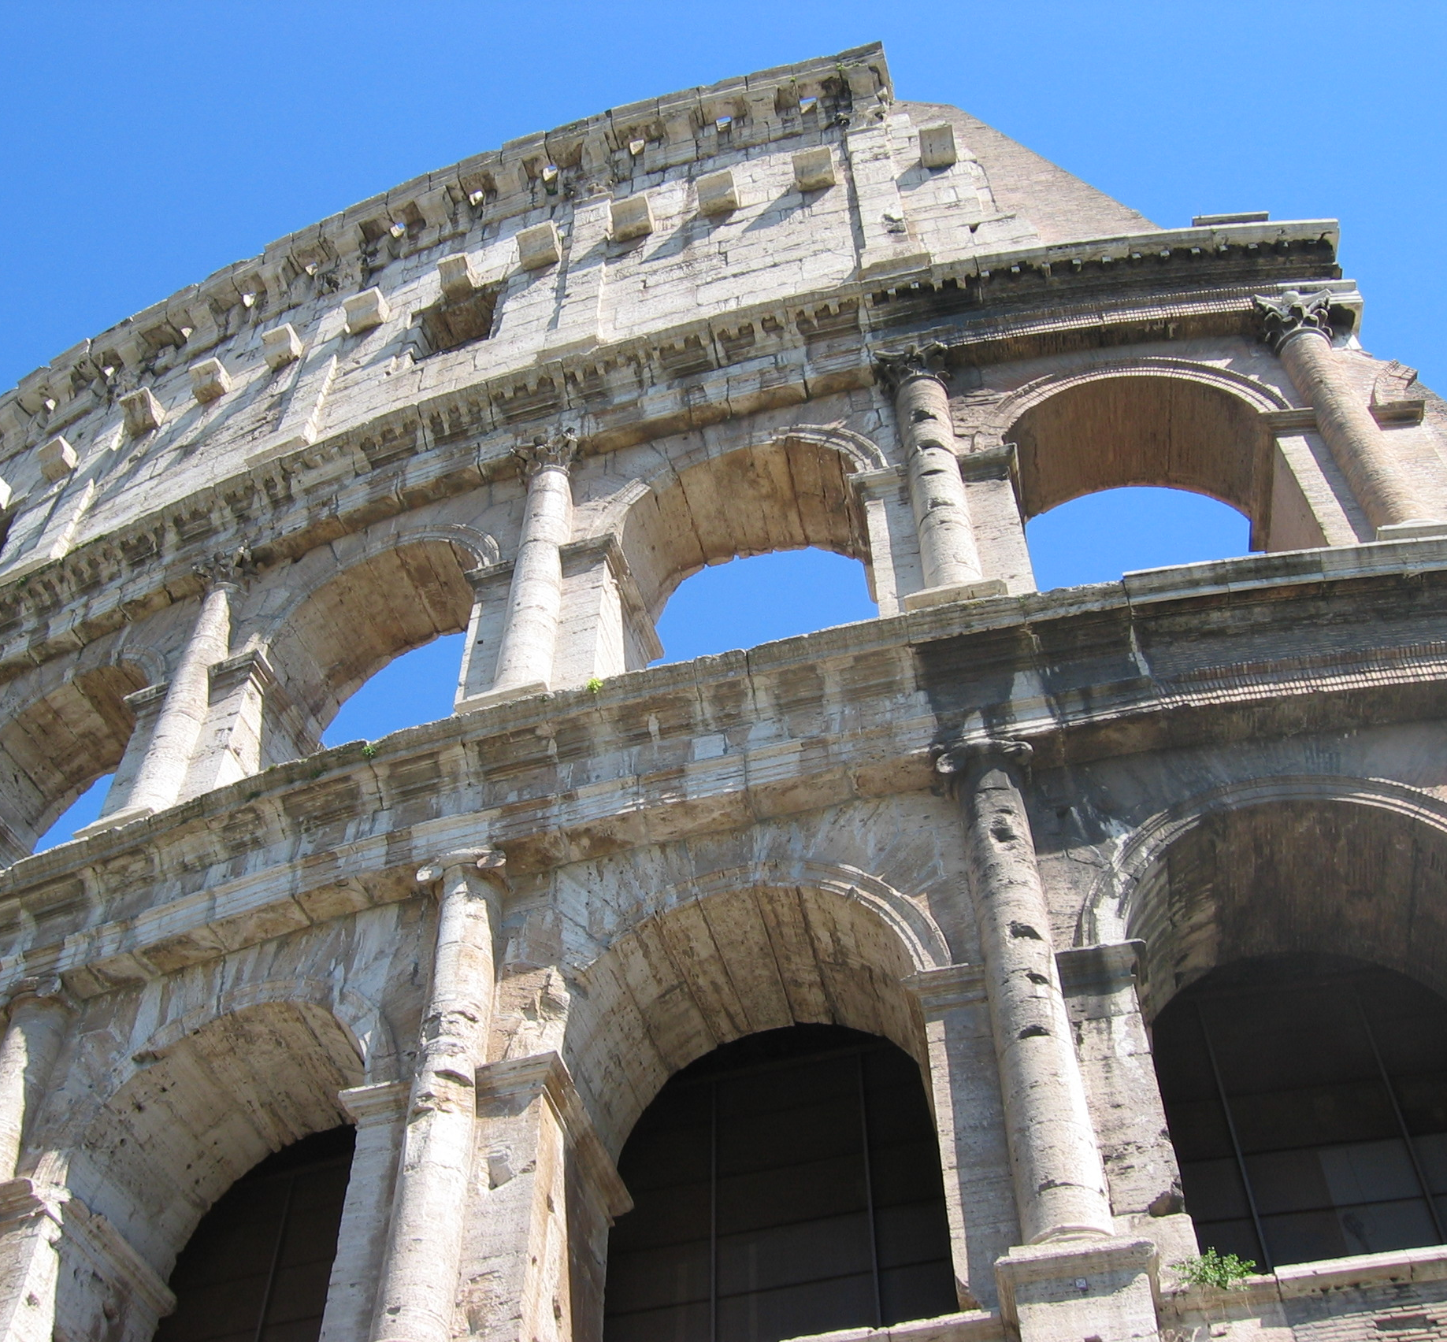
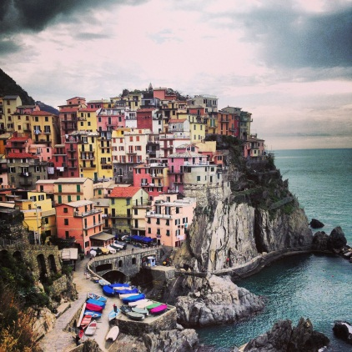
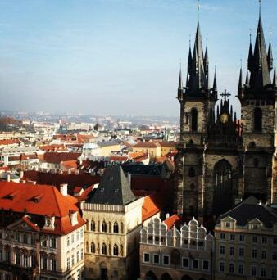
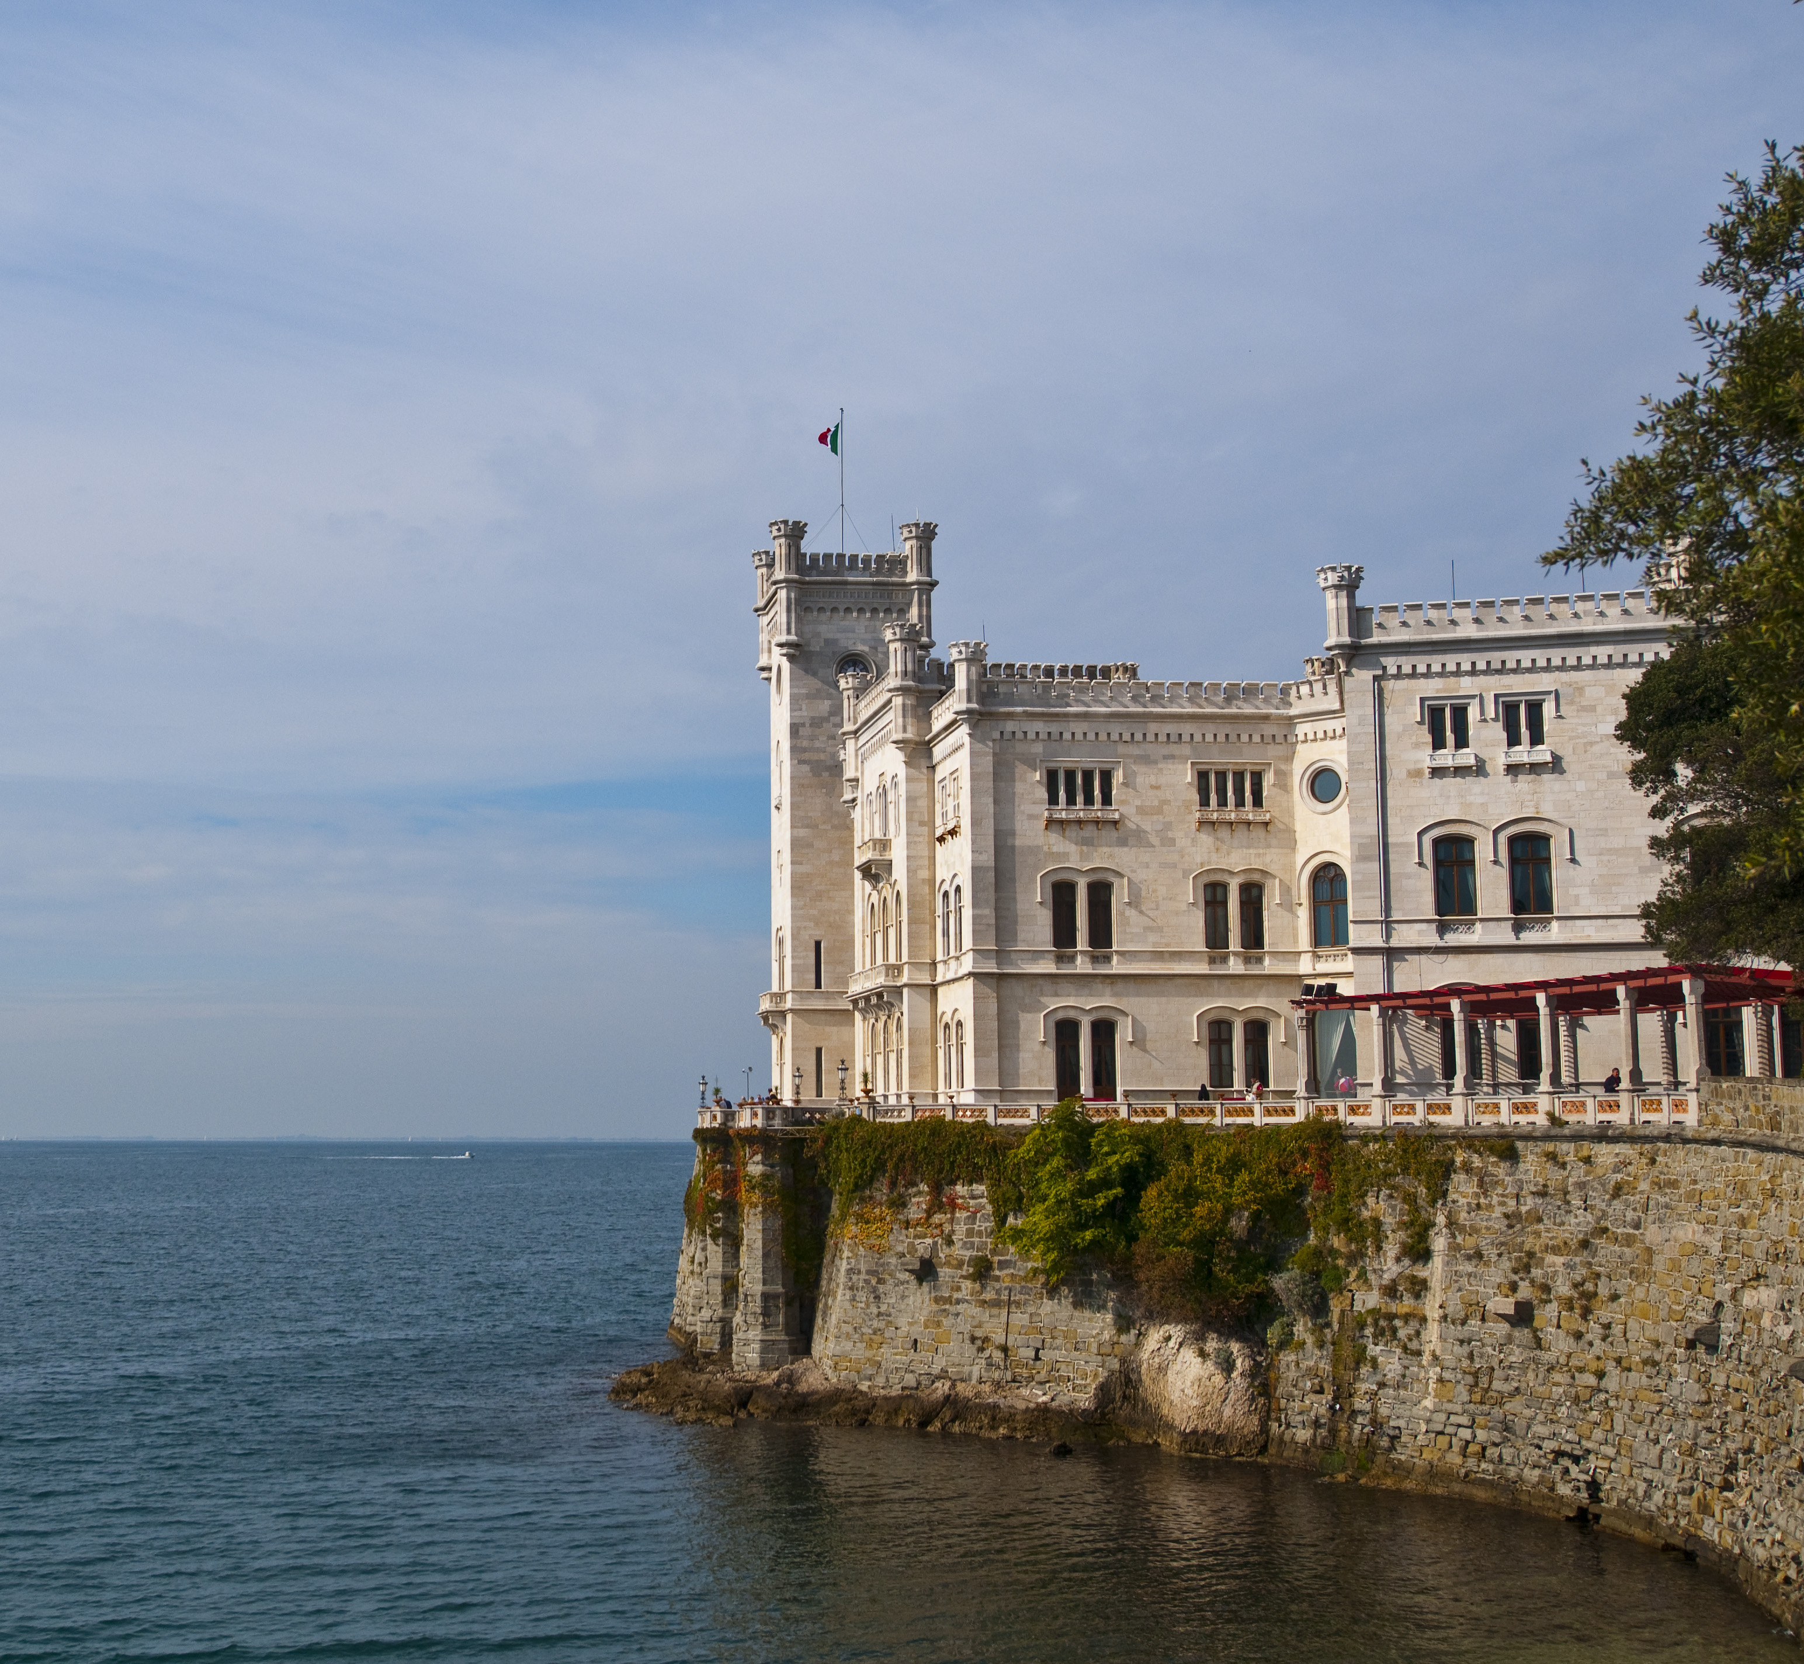
COMMON TRAVEL DESTINATIONS
ITALY
EUROPE
Rome
Florence
Venice
Milan
Triests
Verona
Bologna
Pisa
Siena
Cinque Terre
Capri
Padua
Sorrento
Capri
Palermo
Naples
France
United Kingdom
Ireland
Czech Republic
Belgium
Denmark
Germany
Switzerland
Slovenia
Greece
Portugal
Spain
Hungary
Austria
Norway
Turkey

Slide 11
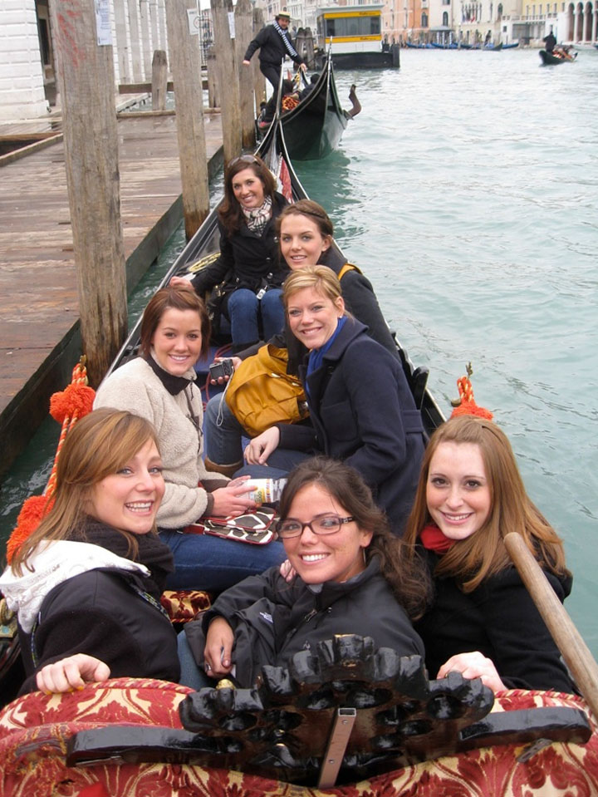
UPCOMING PROGRAMS
Fall 2015
September 14 – December 5
Suggested application date: April 15
All-inclusive tuition cost: $6,385
Spring 2016
January 18 – April 8
Suggested application date: October 15
All-inclusive tuition cost: TBA
(Spring 2015 cost: $16,915)
Tuition includes: academics, dorm room, meal plan, textbooks, wifi, towels & linens, laundry, company tours

Slide 12
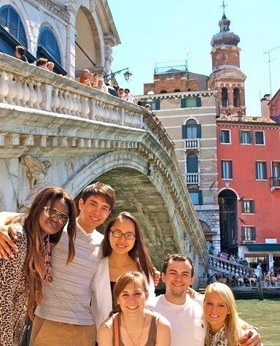
FINANCIAL AID
Using federal financial aid
Set up direct deposit
CIMBA financial awards
Need & merit-based
Resident assistant stipend
Blog ambassador
Social media team
Legacy award
Home university study abroad scholarships
Payment plans available

Slide 13
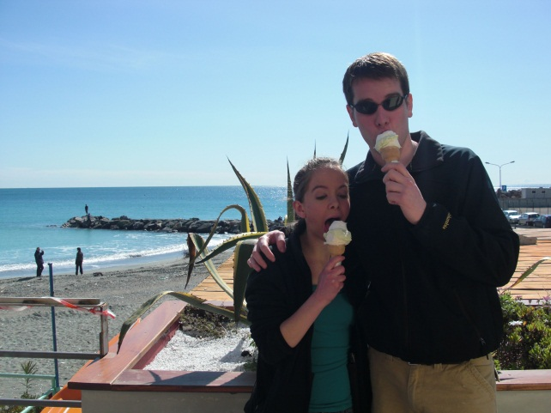
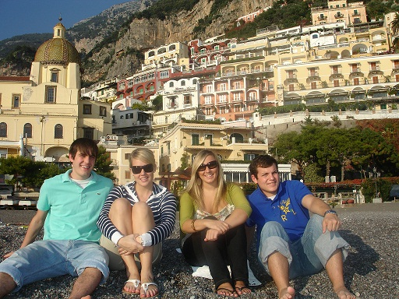
APPLICATION PROCESS
Check with home university for specific procedures
(CIMBA & Your University page)
Online application
www.cimbaitaly.com
Resume
Short personal essay
Forms & Fees
Non-UIowa students: $40 application fee
Non-Uiowa students: send transcript to Uiowa
$500 acceptance fee/deposit
Home university study abroad fee?
Meet with home university advisor
Course equivalencies
Do you need to meet with your home universities study abroad office?

Slide 14
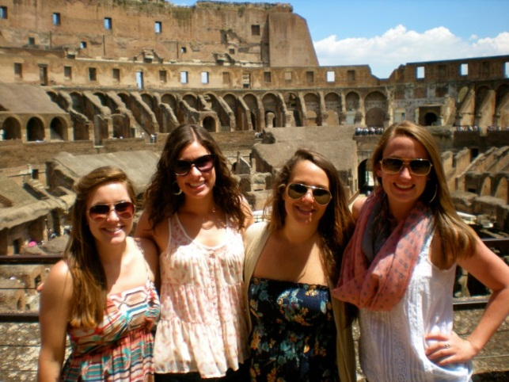
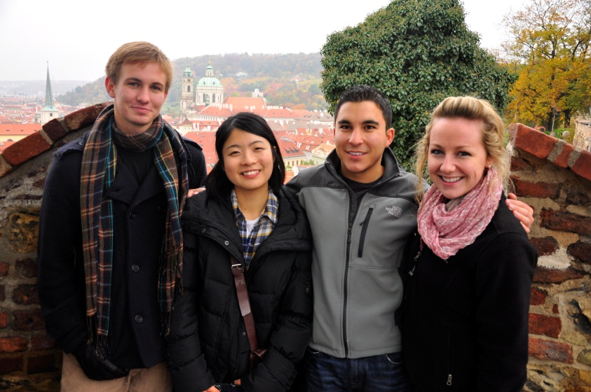
QUESTIONS?
Learn more at www.cimbaitaly.com!
studyabroad@cimbaitaly.com
P: 319-335-0920
Apply today!
Join the conversation!

Slide 15
March 2015
THANK YOU!
For more information check out our new website at: www.cimbaitaly.com

